Slide 1

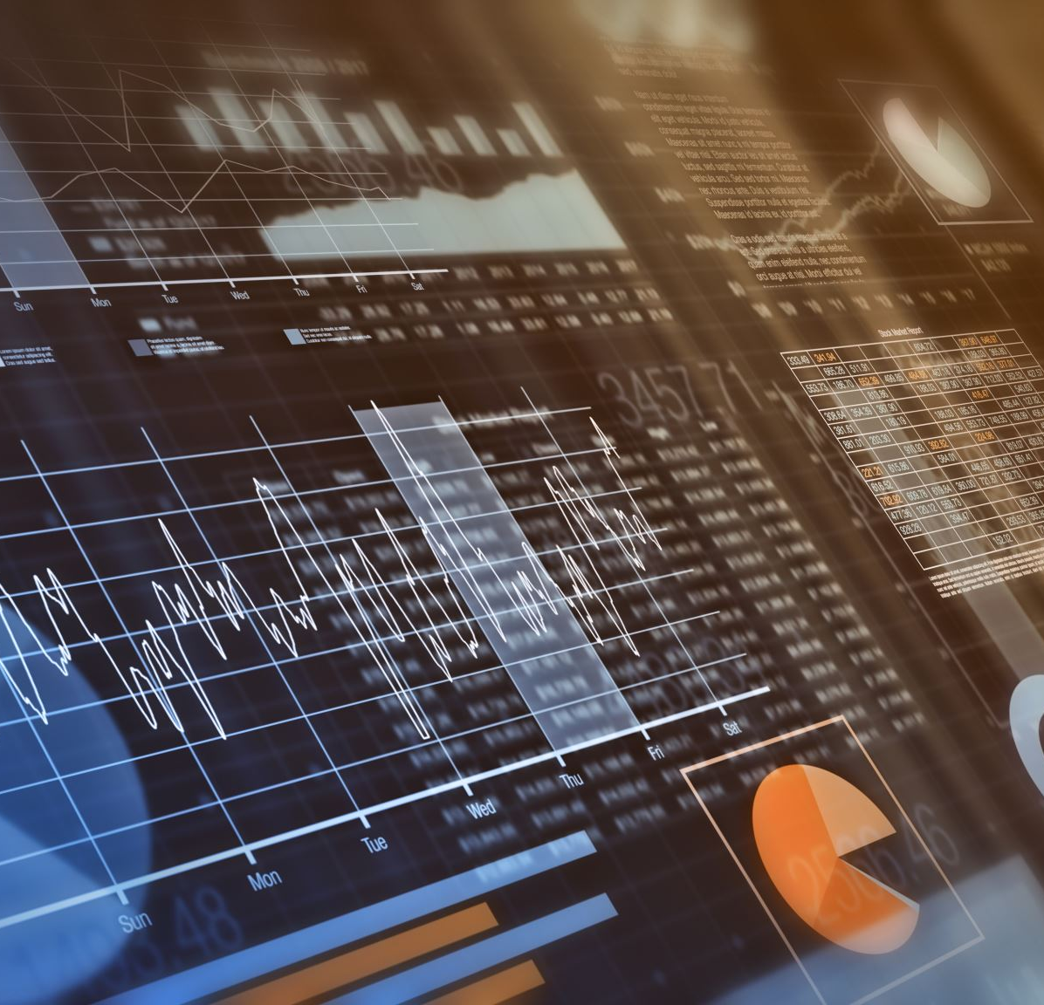




CHAPTER 6 : ACCOUNTING FOR INVENTORY

Slide 2
Learning Outcomes
Explain the term ‘inventory’
Explain the categories of inventory
Determine the cost of goods sold
Determine the purchase cost
Calculate cost of inventory using different formula
Compare and differentiate between the different method of inventory measurement
Compare and differentiate between perpetual inventory and periodic inventory system
Calculate the value of inventory
Explain the techniques for the measurement of cost
Determine cost of inventory using lower of cost or net realisable value
Explain the benefit of inventory management

Slide 3
Definition Of Inventory
Defined by Malaysian Financial Reporting Standards in MFRS Standard 102 as below. Inventories are assets:
held for sale in the ordinary course of business;
in the process of production for such sale; or
in the form of materials or supplies to be consumed in the production process or in the rendering of services.

Slide 4
Categories Of Inventory
Raw Material – Basic materials that a manufacturing company buys from its suppliers and that is used to convert them into the final products by applying a set of manufacturing process.
Work In Progress – Is semi finish product
Finished Goods – Add the manufacturing process to turn these raw materials into finished goods.

Slide 5
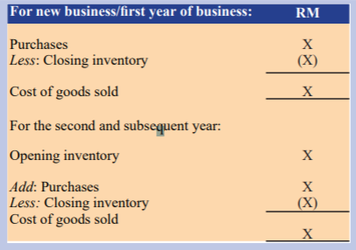
Cost Of Goods Sold
Is an expense which is used to reduce the revenue in the Income Statement of a company.
Determine the cost of the goods sold to identify the gross profit earn.
Can be calculated as shown on the right.

Slide 6
Cost Of Inventory
A business will try to avoid holding inventory for a long period of time as this incur storage cost and give rise to changes of value.
Changes of value can be due to deterioration, obsolescence, change in customer taste, and so on.
Cost of inventories should comprise all costs of purchase, cost of conversion and other costs incurred in bringing the inventories to their present location and condition.

Slide 7
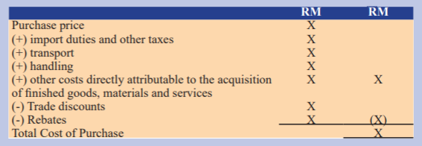
Cost of purchase example

Slide 8
Example of Cost of Conversion
Direct material cost – Substance used in the production of goods that are traceable to the products.
Direct labour cost – wages of workforce that is directly involved in conversion process
Variable production overheads – costs that change in proportion with activity level but are of indirect nature
Fixed production overheads – Costs that do not change in activity level and tend to remain constant for a particular range of activity

Slide 9
Perpetual And Periodic Inventory System
Perpetual Inventory System
Keeps continual track of inventory balances.
Automatically updates and records the inventory account every time a sale or purchase of inventory.
Periodic Inventory System
Conduct physical count of the inventory to determine the ending inventory balance and the cost of goods sold.
Updates and records the inventory at scheduled times at the end of an operating cycle.
Experience a gap between the sale of purchase of inventory and when the inventory activity is recognised.

Slide 10
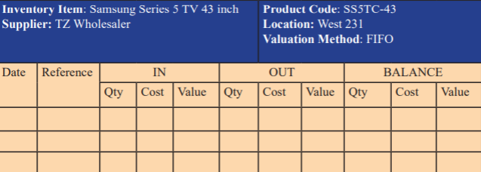
Stock Card
A document that tracks purchases, sales, returns and other drawings.
Tracks the unit price and inventory counts.
Purpose of maintaining stock card is to know how much of each inventory is available.

Slide 11
Cost Formulas
Once the unit cost of inventory is determined, specific costing methods must be adopted such as:
First In First Out (FIFO) – Assumes that inventories that were purchased or produced first are sold first.
Weighted Average Cost – Assigns the average cost of production to a given product.
Last-in, First-out method is not permitted by this new accounting standard because:
International Financial Reporting Standards (IFRSs) shifted its focus from income statement to SOFP.
The focus requires that the figures in SOFP should be according to present market conditions

Slide 12
First In First Out (FIFO)
Products that are bought or produced first are sold first and then the remaining inventories that are most recently purchased or produced.
Oldest cost is matched against revenue and assigned to cost of goods sold.
Most recent purchases are assigned to units in ending inventory.

Slide 13
Advantages Of FIFO
Easy to understand
Save money by reducing obsolete inventory
Disadvantages Of FIFO
Higher tax liabilities due to higher profits earned in inflation.
Challenge when the goods have fluctuating price pattern
Widely used which increases its comparability and consistency.
Save money by reducing obsolete inventory
Cumbersome

Slide 14
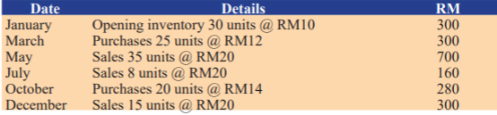
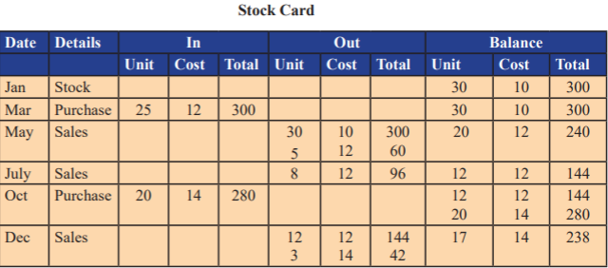
FIFO with Perpetual Inventory System

Slide 15
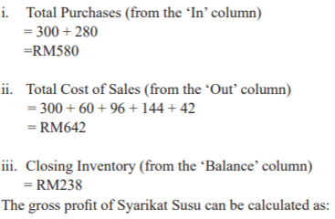

FIFO with Perpetual Inventory System (Cont’d)

Slide 16
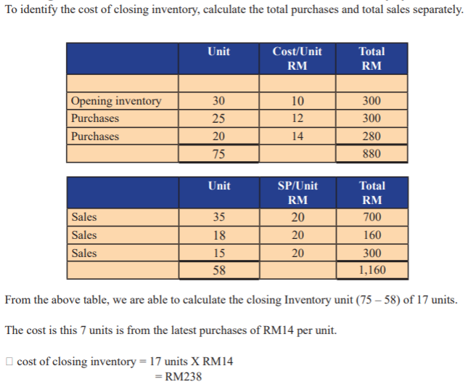
FIFO with Periodic Inventory System

Slide 17
Weighted Average Cost (WAC)
Cost of goods available for sale is calculated as beginning inventory value + purchases.
Units available for sale are the number of units a company can sell or the total number of units in inventory.

Slide 18
Advantages of WAC
Simplest way to track inventory value.
Easily used compare to FIFO
Disadvantages of WAC
When inventory prices vary widely, may suffer a loss with the sales price
Assumption that all units are identical, not realistic.
Calculation is simple
Consistency
Requires fewer labour hours to maintain, thus save cost

Slide 19
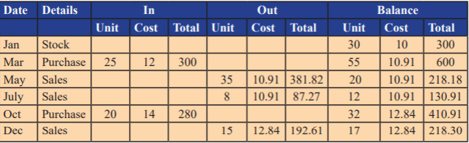
WACC With Perpetual Inventory System
Recompute the weighted average after every purchase.
Stock card is used to keep track of the flow of inventory after each transaction.

Slide 20
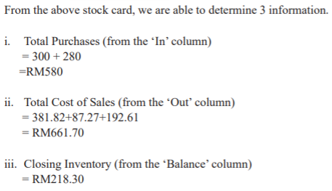
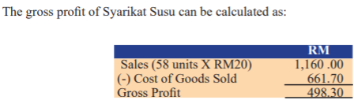
WACC With Perpetual Inventory System (Cont’d)
March = (30 x 10 + 25 x 12)/(30 + 25) = RM10.91 per unit
October = (12 x 10.91 + 20 x 14)/(12 + 20) = RM12.84 per unit

Slide 21
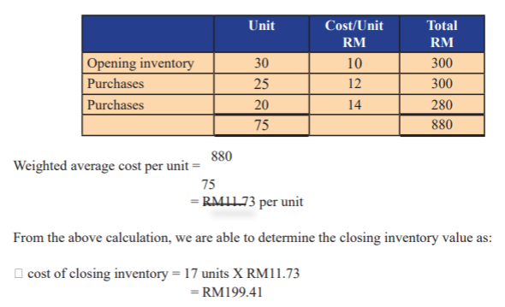
WACC With Periodic Inventory System
Sum up the cost of opening inventory and the total purchases to divide with total unit.

Slide 22
Techniques For The Measurement Of Cost
In some special circumstances, it is difficult to determine cost of inventory. Thus, different methods are used to give approximate figure that reliable:
Standard costing method – Setting costs in advance considering the normal production output.
Retail costing method – Determine cost of inventory by reducing the sales value of the inventory by the appropriate percentage gross margin.

Slide 23
Net Realisable Value (NRV)
Sometimes cost of inventories may not be recoverable
That happens when inventories are damaged, obsolete, or their selling prices have declined.
If this happens, then net realizable of the inventory is to determine.
NRV is the value for which an inventory can be sold, minus the estimated costs of selling
Calculation of NRV is critical because it prevents the overstatement of the inventory’s valuation.

Slide 24
Net Realisable Value (NRV) (Cont’d)
NRV can calculate using into the following steps:
Determine the market value or expected selling price of the inventory.
Find all costs associated with the completion and the sale of the inventory (cost of packaging, advertising, transportation, commission).
Calculate the difference between the market value (expected selling price of the inventory) and the costs associated with the completion and sale of the inventory. It is a net realisable value of the inventory.

Slide 25
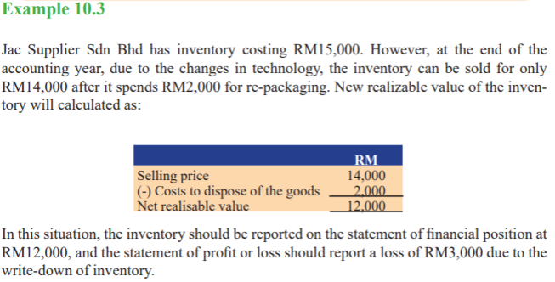
NRV Question & Answer

Slide 26
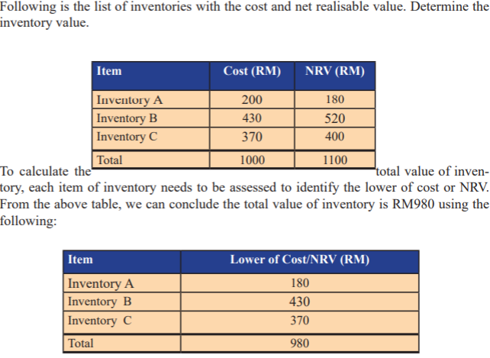
NRV Example and Answer
Example 10.4 on the right, shows how to calculate NRV.

Slide 27
Benefits Of Inventory Management
Benefits of good inventory management includes:
improves the accuracy of inventory orders.
helps save time and money.
keeps your customers coming back for more.
NRV complies with a more conservatism approach to accounting. The conservatism approach directs accountants to use valuation methods that generate a smaller profit and do not overstate the value of assets in situations when professional judgement is required for the evaluation of the transactions.

